Slide 1
Report
June-2023 MP Inspection BFX – UA300
Date : 22-Aug-2023
Prepared by: Rachel Ruan

Slide 2
Issue Description
25-Jul, ALT customer complain [BFX-UA300] June – 2023 Mass production issue.
Overall inspection result => Conditional Pass (Waived)
Defect Total:
• Critical
1. No sound output * 1pcs
• Major
1.NTF issues related Button * 2pcs
2. Poor paint finish * 5pcs
End user defect
• Major
1. BTV logo plate missing * 1pcs

Slide 3

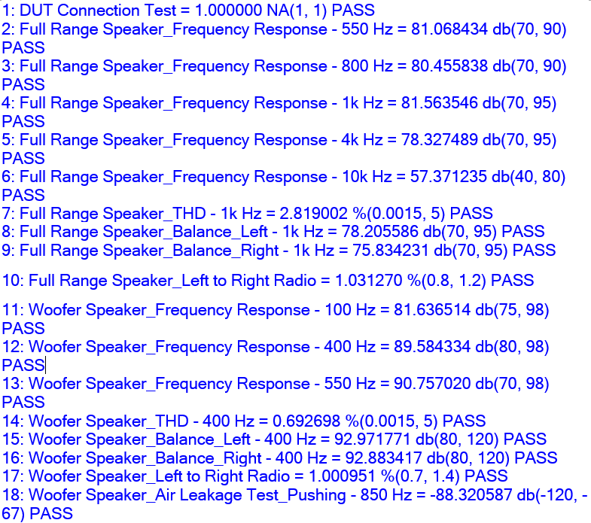
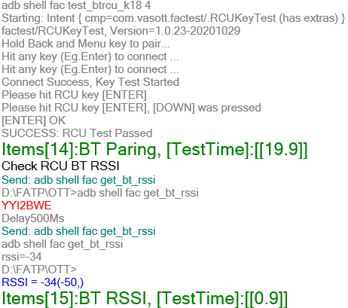
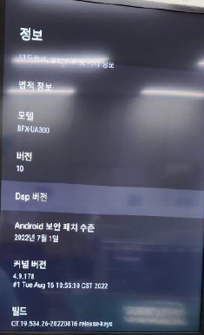
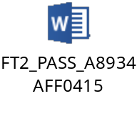
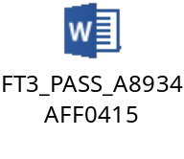
1. No sound output * 1pcs
Issue Description | Root cause | Actions | Status
Symptom: No sound output Type: Critical Defect unit Q’ty : 1/315pcs Defect rate : 0.31% SKB SN: 2149695001202303008052 | Check FATP data Product test pass normally Focus FT2 & FT3 station (Funtion test coverage): ➔ RCU and soundbar OK normal, Result: PASS | Visual inspection and Xray normal Measure impedance FFC cable OK normal. Swap FFC cable and retest FATP and function OK normal. (Run-in 10hours) ➔ Suspect FFC connection is not good, PE keep monitoring on FATP for this issue.
FT2 station
FT3 station

Slide 4

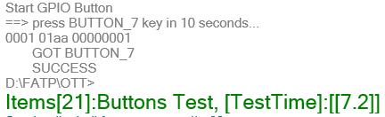

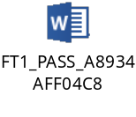

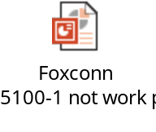
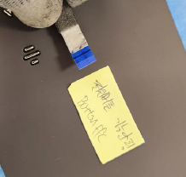
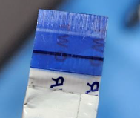
2. NTF issues related Button * 2pcs
Issue Description | Root Cause | Action | Status
Symptom: NTF issues related Button Type: Critical Defect unit Q’ty : 2/315pcs Defect rate : 0.63% SKB SN: 2149695001202303008040, A8934AFF04C8 2149695001202303008046 A8934AFF04F1 | Check FATP data Product test pass normally Focus FT1 station (Function test coverage): ➔ Button work normal , Result: PASS 1. Visual inspection FFC cable , x-ray find out abnormal 2. Measure impedance FFC cable found out signal button Power ON, CH-,Ch+ open 9,35Kom. Swap FFC cable and retest FATP and function ➔ Power, CH-, Ch+ button not working. => Root cause : Button FFC cable abnormal. | 1. FT1 test station can cover 100% button function issue. ( Button NG- Not work power button STB. & Button NG - when button BT is pressed, sound effect button is also pressed ) 2. 21-Aug-2023, P-TWO Vendor feedback FA report. They confirm the electrical test found that 5parts of the defective conductor were OPEN. Check X-Ray found X-ray detection shows that there is a conductor fracture at the A end of FFC cable. 3. Root Cause: At the A end of the conductor, the reinforcement plate is bent and the conductor is warped and broken. Suggestion may be operation doing wrong method make the conductor to break , resulting in poor operation. 4. Corrective Action: 4.1 : Electrical inspection in P-TWO can 100% detect defective products, it can effectively prevent conductor warping and conductor breakage. 4.2: Fii-FATP can cover 100% button function issue by testing ( FT1 test station check all button function ) 4.3: Fii keep monitoring on FATP for assembly FFC cable issue.

Slide 5
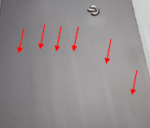
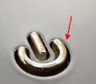

3. Poor paint finish * 5pcs
Issue Description | Root cause | Actions | Status
Symptom: Poor paint finish Type: Major Defect unit Q’ty : 5/315pcs Defect rate :1.58% SKB SN: 2149695001202303009873, 2149695001202303005343, 2149695001202303005901, 2149695001202303005905 | 1. Occurrence Root cause : Incoming housing issue. => Waiting vendor Inkel provide corrective action and 8D report. 2. Escape Root cause: Fii visual inspection SOP no defined reject this issue ( Pic 1 & 2) . No quality alarm notification to OP to know reject. 3. Fii check Visual inspection criteria ( Rev02) ALT provided, had define peeling issue is PASS ( Pic 3 ). Make SOP no define reject peeling issue. | 1. Update NG picture into SIP – IQC , hang Quality alarm on IQC area check and notice this case. If checked NG housing, will reject and return back the vendor. Done. SQE-26-Jul-2023. 2. Update SIP visual inspection at OBA notification housing surface stain, clumps issue. Hang Quality alarm with big picture NG housing. Reject when checked NG issue. Done. PQE-26-Jul-2023. 3. Hold and inform to vendor housing surface stain, clumps issue, vendor sorting 100% before ship to Fii. Done. ZYX vendor
Pic.2
Pic.3
Pic.1

Slide 6
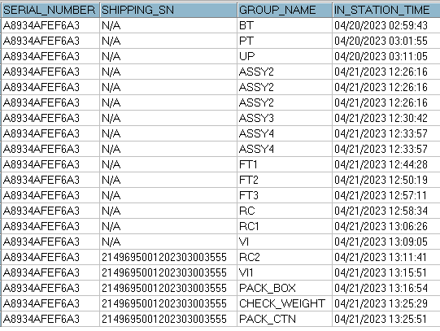
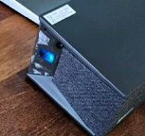
4. BTV logo plate missing * 1pcs
Issue Description | FA | Root cause & Actions | Status
Symptom: BTV logo plate missing Type: Major Defect unit Q’ty : 1/315pcs Defect rate : 0.31% SKB SN: 2149695001202303003555 | Check FATP data Product assembly & test function pass normally. No abnormal issue. 2. Check from links to finished product the time each station no abnormal. -> No rework or repair data. | 1. As customer image about BTV logo, maybe some one peeled it out of product. We check production data no abnormal issue. 2. Add Side Deco plate checking is a CTQ item in SOP VI station. 3. Training all OP by Quality alert customer high light inspection issue with K18 product. 4. We keep monitoring on FATP for BTV logo missing issue.

